Slide 1
Exploratory Data Analysis for Online Retail Dataset Insights and Recommendations Based on Regional Analysis Prepared by : Sarah Alabbadi Date:4/1/2025

Slide 2
Introduction
This presentation focuses on analyzing sale data for an online United Kingdom retailer.
Time period: December 2010- December 2011
Objective:
Segment data into three regions (Asian,Non Asian,and United Kingdom)
Derive region specific insight to optimize sales strategies.

Slide 3
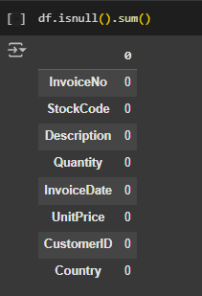
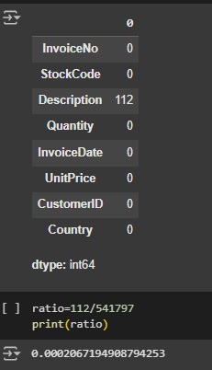
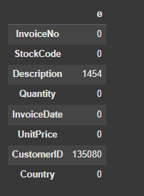
Data cleaning process
Filled missing Customer ID with a value 0
Imputed missing Descriptios using corresponding Stock Codes
Deleted rows with other missing valuer as the accounted for only 0.02% of the dataset .

Slide 4
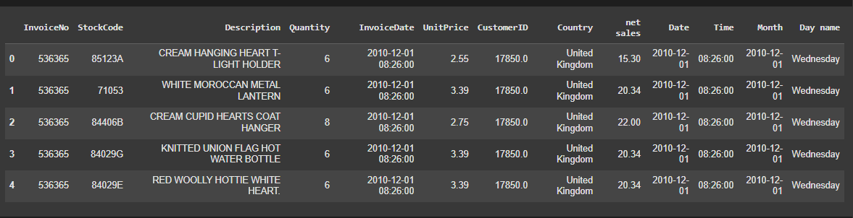
Added a new columns to segment data like Net sales
Extracted the date and time into separate columns fo better analysis
Created a "Day name"columns to better analyze trends by weekdays

Slide 5
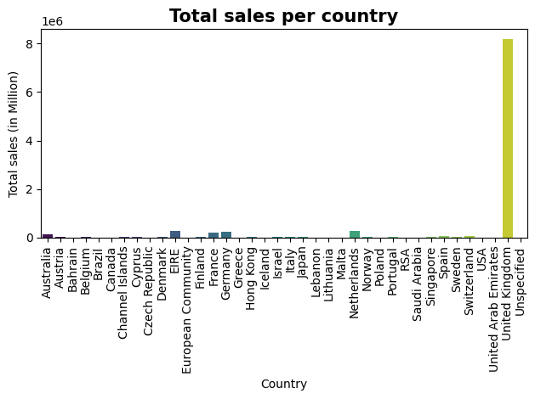
Total sales per country
Because of the big difference in sales , we found a way to give clearer insights.

Slide 6
Approaches Data segmentation Approach
Data was divided into three categories:
-United Kingdom
-Asian region
-Non Asian region
Each category was analyzed for key matrics like total sales ,average sales,product performance, and customer behavior.

Slide 7
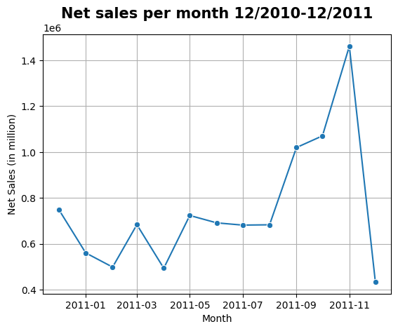
Net sales per month from 12/2010-12/2011
sales were low at the beginning of the year but started to increase significantly as the months progressed. A sharp rise is observed in October and November, indicating a peak sales season likely due to events or seasonal promotions then the trend drops sharply in December.

Slide 8
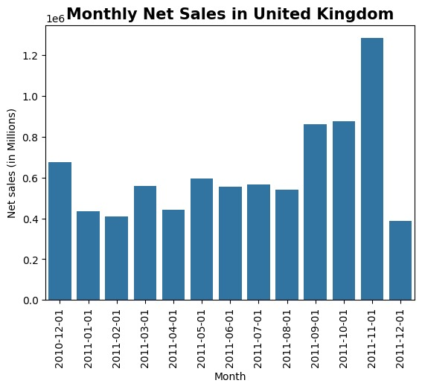
Insights United Kingdom
Dominates total sales across all regions
Total net sales 8187806.3
monthly net sales in the United Kingdom a significant increase in sales is observed during the last quarter of the year, which may reflect the impact of the holiday season and celebrations on sales

Slide 9
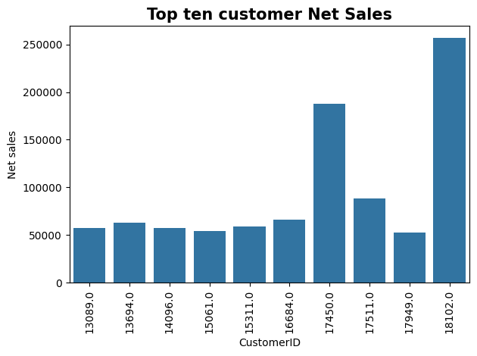
Key customers in United Kingdom
Key customers: 18102 and 17450 contributed significantly

Slide 10
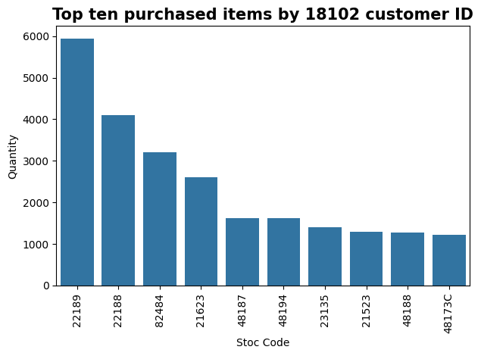
The best selling product by 18102 customer
The best selling product 22189 StockCode
The description for this product (CREAM HEART CARD HOLDER)

Slide 11
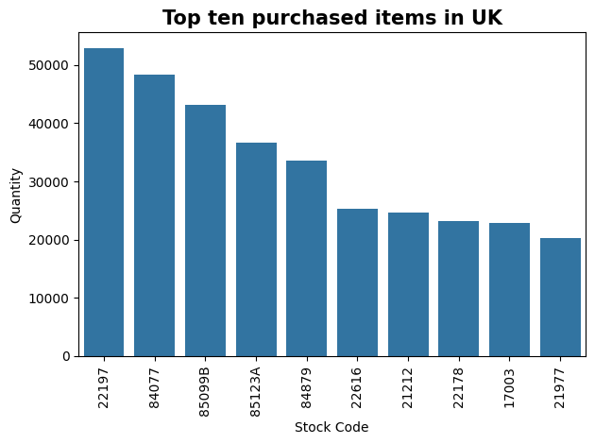
Best selling product in UK as a Quantity
22197 is POPCORN HOLDER
84077 is WORLD WAR 2 GLIDERS ASSTD DESIGNS

Slide 12


22197 is POPCORN HOLDER
84077 is WORLD WAR 2 GLIDERS ASSTD DESIGNS

Slide 13

Asian countries
Japan
Cyprus
Israel
Bahrain
Greece
Hong Kong
Singapore
Lebanon
United Arab Emartes
Saudi Arabia

Slide 14
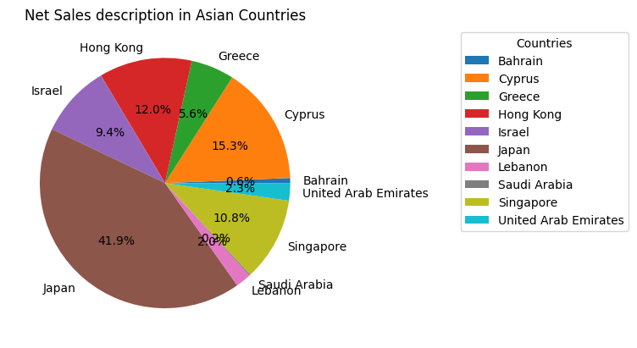
Net Sales description in Asian Countries
-Japan holds the largest share at 41.9%, indicating its significant contribution to sales in the region.
-Cyprus ranks second with 15.3%, Singapore at 10.8%

Slide 15
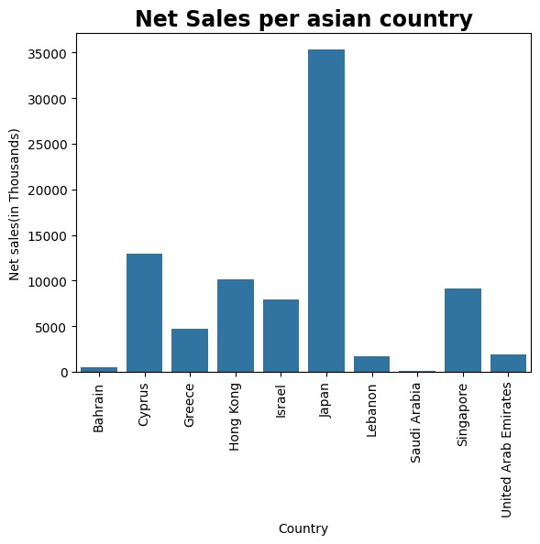
Insights Asian Region
Results:
Total net sales 84418.41
Most purchased country is Japan
Low overall cancellation rates

Slide 16
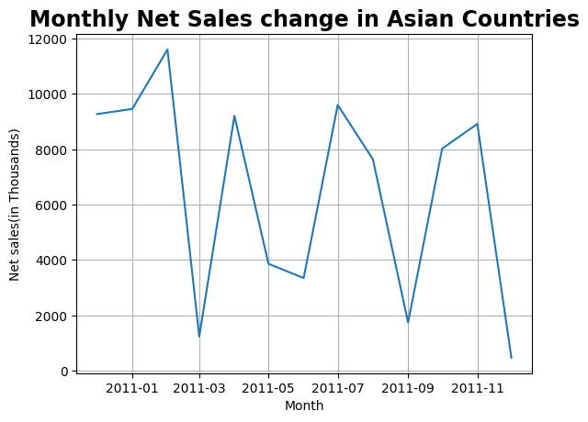
Monthly Net Sales change in Asian Countries
Results:
The highest sales point was at the beginning of the year (January), while there were significant drops in May and september and December
The peak season in Asian countries :
Spring (March to May): • Cherry Blossom Season
. Winter (December to February): • New Year

Slide 17
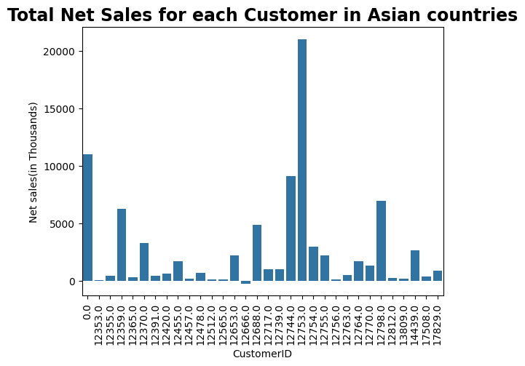
The most purchased customer in Asian country
Key customer: 12753 in Japan

Slide 18
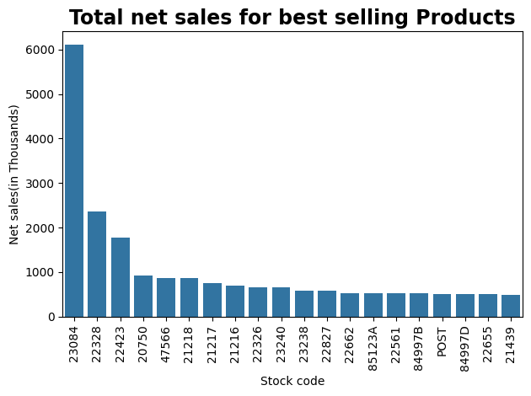
Total net sales for best selling Products
The product with the stock code "23084" achieves the highest sales compared to other products.

Slide 19

The product with the stock code "23084" is RABBIT NIGHT LIGHT

Slide 20
Non-Asian countries
France', 'Australia', 'Netherlands', 'Germany', 'Norway', 'EIRE', 'Switzerland', 'Spain', 'Poland', 'Portugal', 'Italy', 'Belgium', 'Lithuania', 'Iceland', 'Channel Islands', 'Denmark', 'Sweden', 'Austria', 'Finland', 'Czech Republic', 'Canada', 'Unspecified', 'Brazil', 'USA', 'European Community', 'Malta', 'RSA

Slide 21
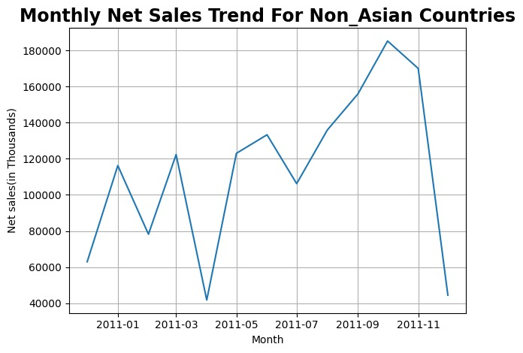
Monthly Net Sales Trends for Non_ Asian Countries
The sales increase in September then decline at the end oof the year
Non-Asian countries are affected by the Beck Season more than Asian countries.

Slide 22
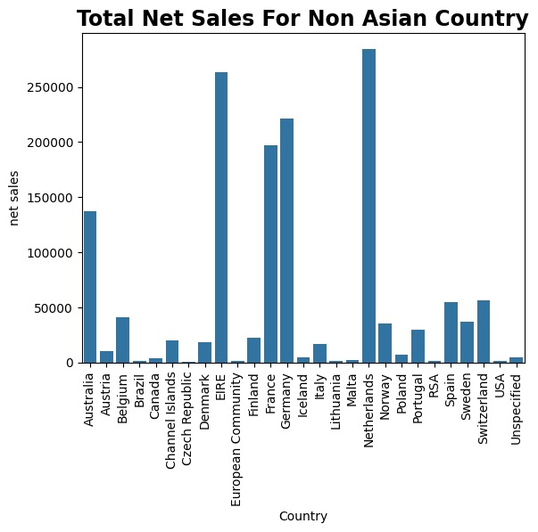
Insights Non_Asian Region
Total Net Sales in non Asian countries 1475523.16
Key contributing countries:Netherlands,France,Germany and EIRE.

Slide 23
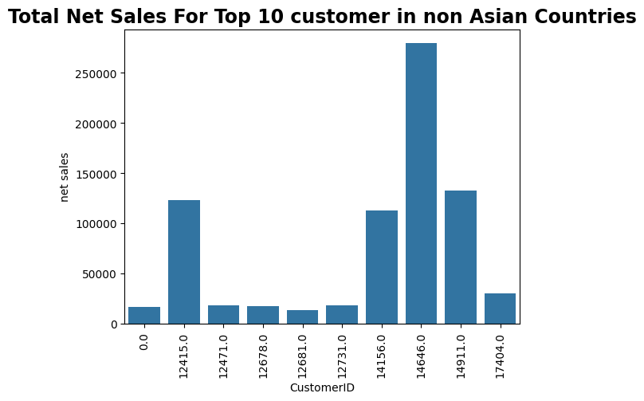
Total Net Sales For Top 10 customer in non Asian Countries
Key customers: 14646 has the highest net sales.
Customers 14911,12415 and 14156 have similar total purchases.

Slide 24
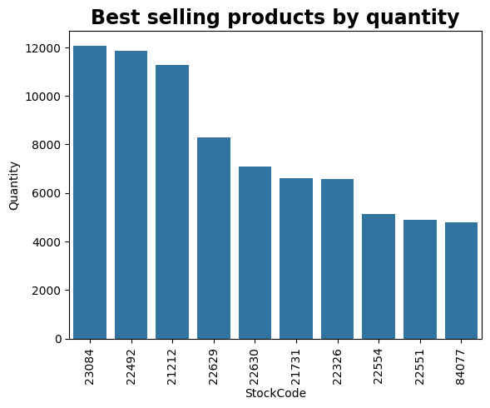
Best Ten selling products by quantity in Non_Asian countries
The Stockcode 23084( RABBIT NIGHT LIGHT)
22492 (MINI PAINT SET VINTAGE)
and 21212 (PACK OF 72 RETROSPOT CAKE CASES)have the most Quantities selling

Slide 25


The Stockcode 23084( RABBIT NIGHT LIGHT)
22492 (MINI PAINT SET VINTAGE)
21212 (PACK OF 72 RETROSPOT CAKE CASES)have the most Quantities selling

Slide 26
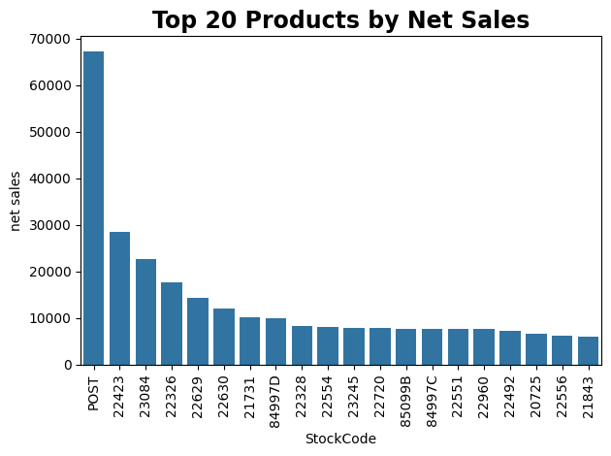
Top 20 Products by Net Sales
Post is Postage refers to the shipping or delivery fees associated with sending products to customers These charges vary based on factors like the customer’s location, the quantity of items, or the delivery method.
Or maybe postage
22423 and 23084 stock code had most pyrchased in non Asian countries.

Slide 27
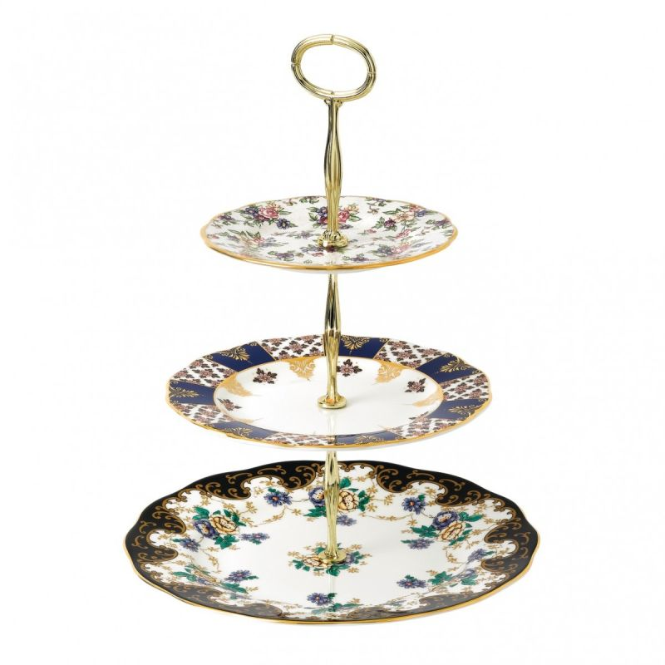


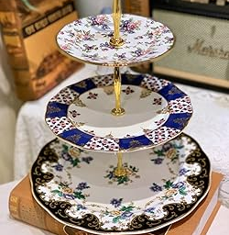
Post is Postage refers to the shipping or delivery fees associated with sending products to customers These charges vary based on factors like the customer’s location, the quantity of items, or the delivery method.
Or maybe postage
22423 and 23084 stock code had most pyrchased in non Asian countries.

Slide 28
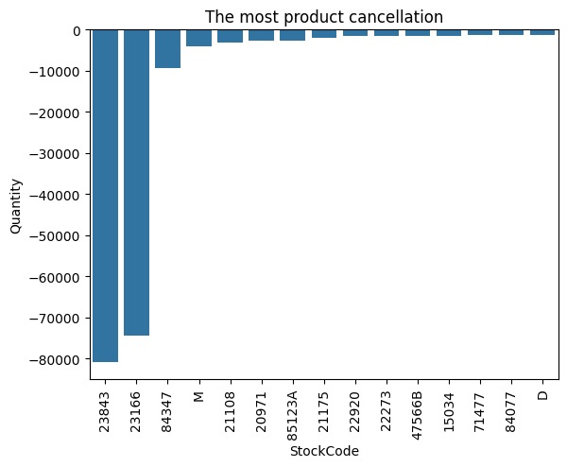
Cancellations Analysis
Product like 23843 and 23166 have the highest cancellation rates
Cancellations often linked to popular product with high order volumes

Slide 29


Cancellation products
23843 PAPER CRAFT , LITTLE BIRDIE
23166 is MEDIUM CERAMIC TOP STORAGE JAR

Slide 30
Recommendations for cancellation incidents
Investigate
Investigate​
Investigate reasons for high cancellations like​
Improve
Improve​
Improve product descriptions and images to manage customer expectations ​
Offer
Offer​
Offer incentives for order instead of cancellations ​

Slide 31
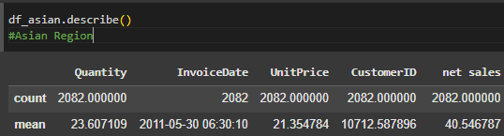
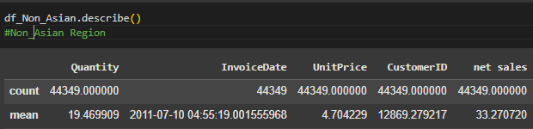
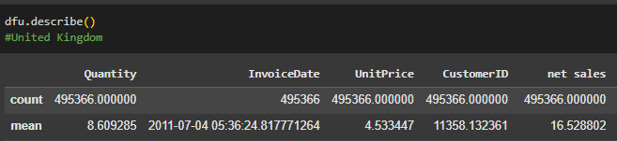
Average purchase transaction for each region
Average net sales in unitd kingdom 16.5
Average net sales in Asian Rgion 40.5
Average net sales in non_asian region 33.2

Slide 32
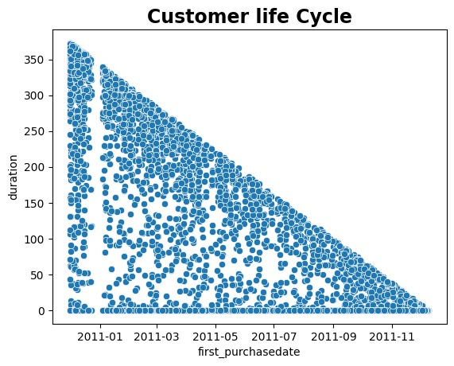
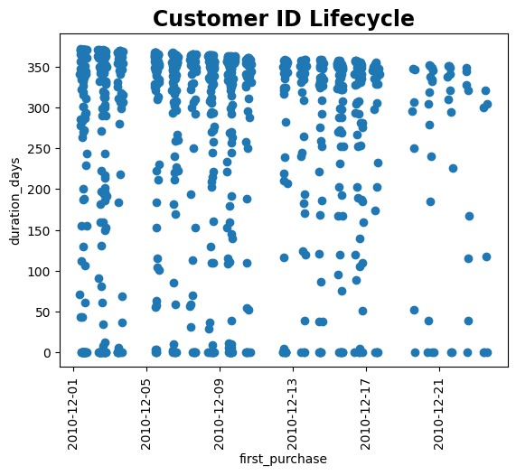
Average duration for customer=266 Days

Slide 33
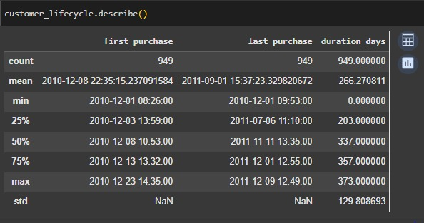
25% of customers have a duration with the company of 203 days or less
50% of customers have a duration with the company of 337 days or less
75% of customers have a duration with the company of 375 days or less

Slide 34
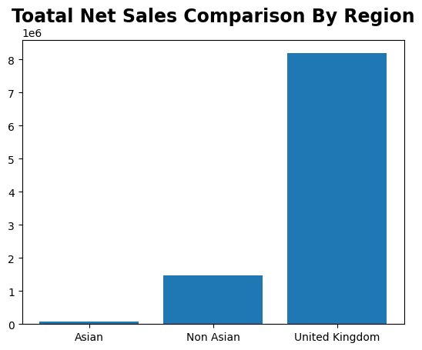
Total sales comparison by region
The United Kingdom accounts for the majority of sales
Non Asian regions contribute a small but steady portion
Asian regions show potential but have a smaller total share

Slide 35
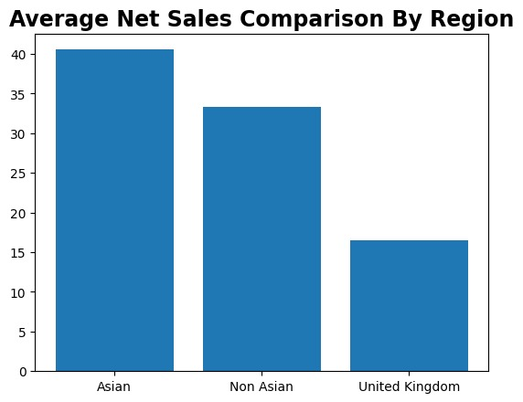
Average sales comparison by region
Asian regions lead in average sales per transaction ​
Uk shows lower average sales despite dominating total sales ​

Slide 36
Recommendations:
Customers :
Target low –revenue customers with promotions .
Reward loyal customers with discounts or exclusive offers
Products :
Stock more units of best-sellers
Investigate reason for high cancellations and improve product quality .
region :
Expand operations in high performing regions like Asia
Optimize pricing and logistics for the UK market

Slide 37
conclusion
Data segmentations highlighted unique patterns in each regions
Recommendations focus on optimizing performance in specific areas
The analysis provided insights into customers behavior ,products performance and regional trends
Implementing the recommendations will improve sales performance and customer satisfaction
Continuous monitoring and analysis are essential for long term success

Slide 38
Q&A
Open for discussions and questions
Thank you for attentions

